Slide 1
Level 2
Student’s name:

Slide 2

Watch this video http://www.youtube.com/watch?v=kUzzSMXSkcE and learn how to give advices.
Write the sentences that you see, using SHOULD
ENGLISH | SPANISH

Slide 3

Go to http://www.youtube.com/watch?v=ag1t3cJmKQg&feature=related and learn how to make negative and interrogative sentences.
Write next sentences using SHOULD, according to the example:
1. The teacher is making exams every day | He shouldn’t make exams every day
2. My brother is playing all day
3. That baby is eating much candy
4. Taxes are increasing in Colombia
5. Those students are very lazy
6. I worry about simple things
7. you’re speaking English too slowly
8. Violence is a reality
9. Pollution is affecting the environment

Slide 4

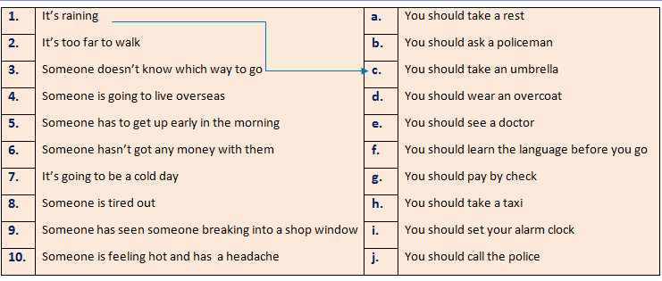
 | Activity. Match the sentences, in order to have a complete and logical meaning.
1 | It’s raining, you should take an umbrella.
2
3
4
5
6
7
8
9
10

